Slide 1
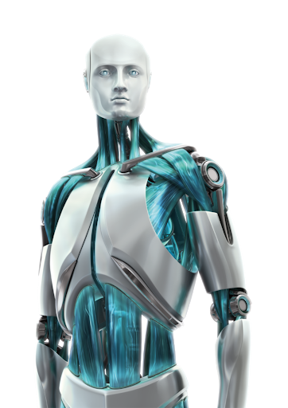


THE IDEA OF MACHINE LEARNING
LEARN FROM EXPERIENCE
LEARN FROM DATA
TAKES INSTRUCTIONS

Slide 2
WHAT IS MACHINE LEARNING?
“Machine Learning is the field of study that gives computers the ability to learn without explicitly programmed.”

Slide 3
TRADITIONAL SYSTEMS VS MACHINE LEARNING
Traditional Systems
DATA
PROGRAM
RULE BASED PROGRAMS
OUTPUTS
DATA
MACHINE LEARNING ALGORITHMS
OUTPUTS
Machine Learning

Slide 4
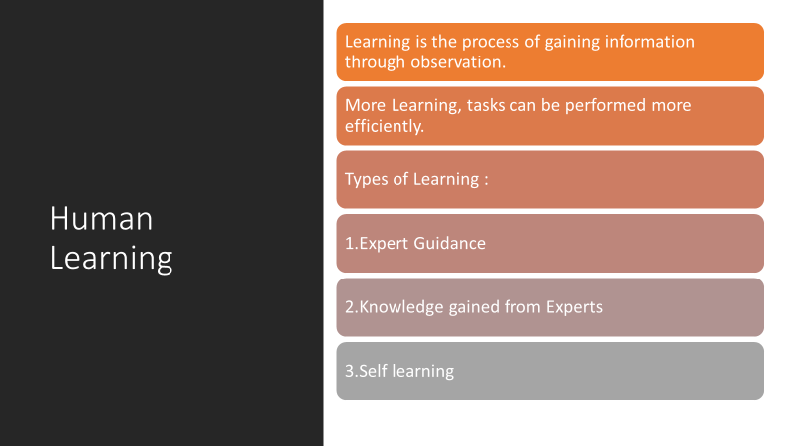

Slide 5
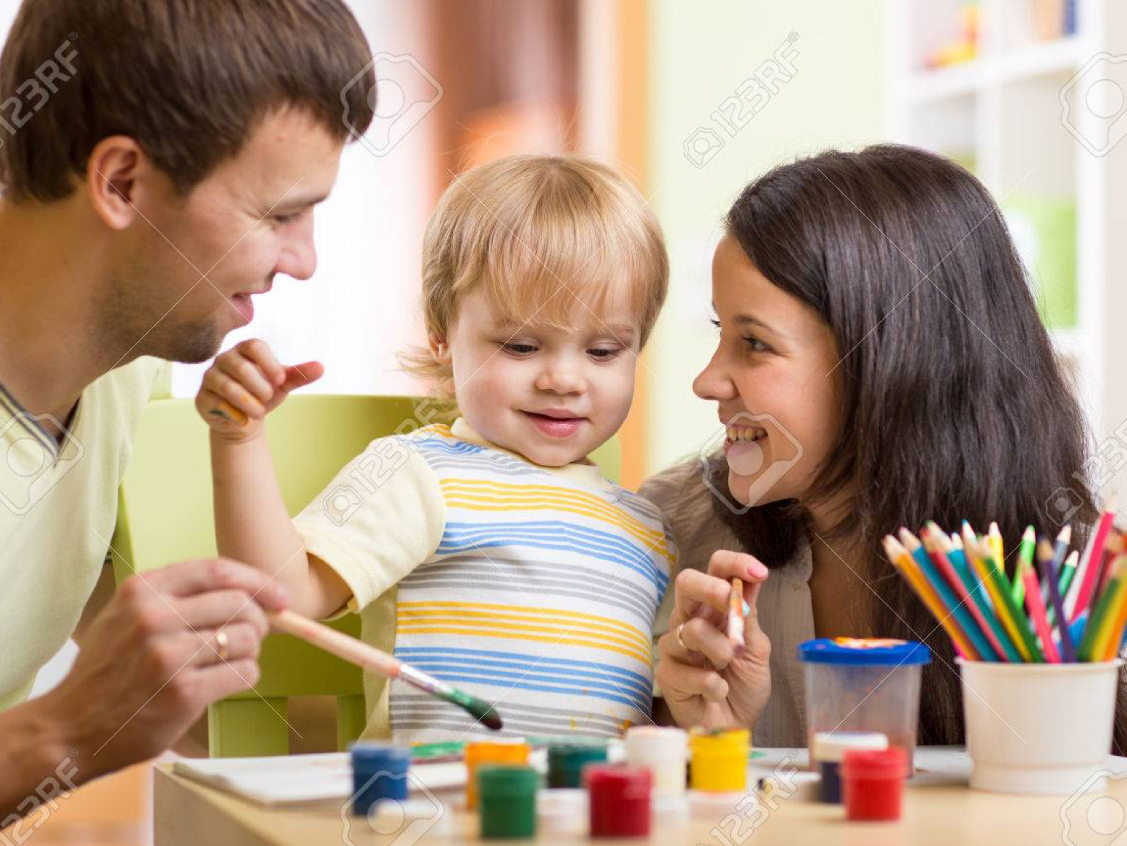

Slide 6
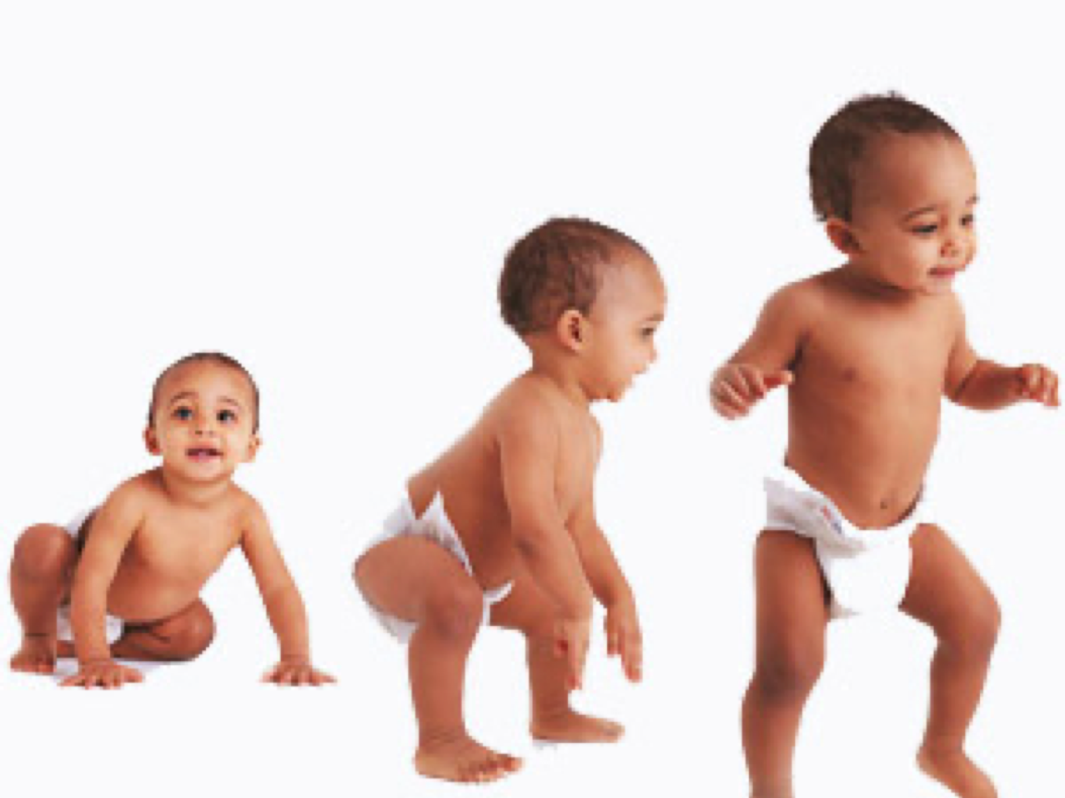

Slide 7
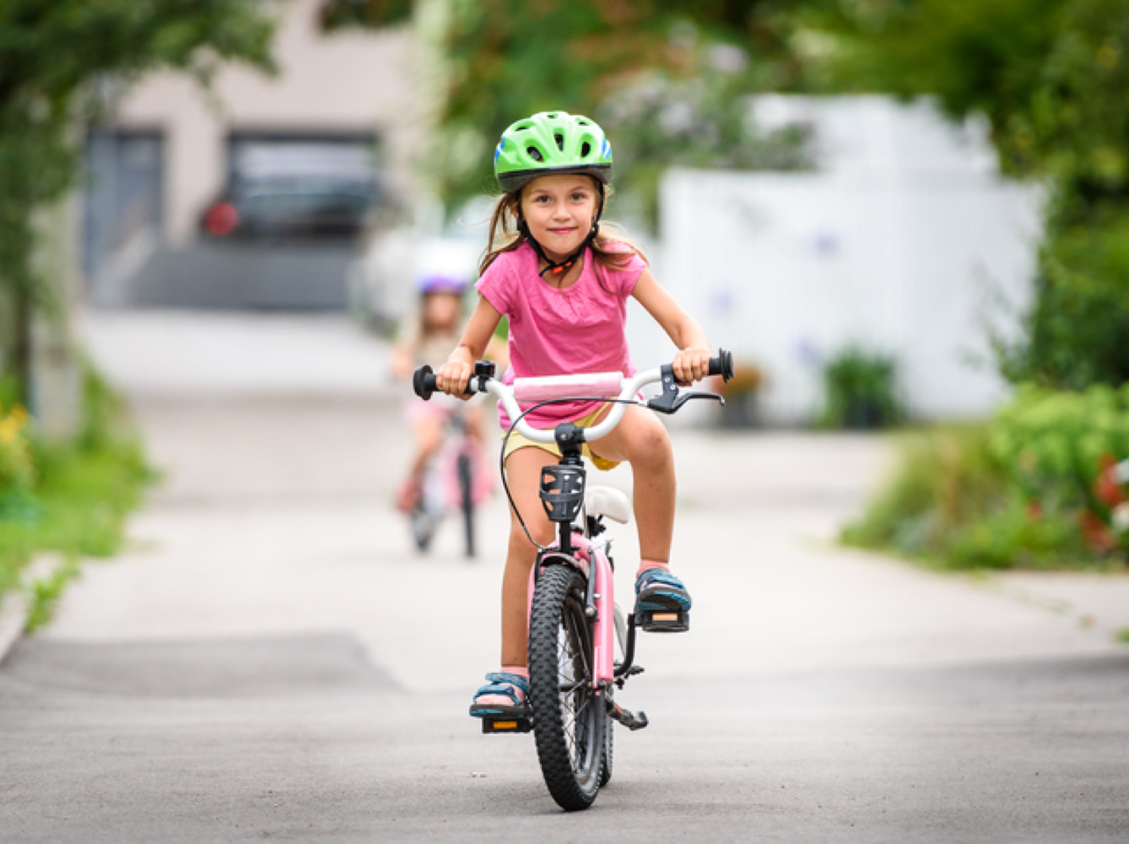

Slide 8
Has been in the picture from the past 50 years
Initially coined by Arthur Samuel in the year 1959 as Field of Study that gives computers the ability to learn without being explicitly programmed.
It was not that significant as of today 25 years ago.
Best definition by Tom Mitchell -A Computer Program is said to learn from experience "E" with respect to some class of tasks "T" and performance measure "P", If its performance at tasks in "T“ as measured by "P", improves with experience "E".
Machine Learning

Slide 9
22 years ago IBMs Deep Blue beat World Chess Champion Gary Kasparov, which marked the importance and gave people a serious attention.
Then in the 21st century everything has seen exponential growth in the development and applications.
2006 marked the word Deep Learning by publications made by Geoffrey Hinton from the concept of Deep Belief Nets.
2011 IBM Watson beat Human champions in Jeopardy.
Google started Brain Team and X Lab.
2014 FaceBook Face Tagging (DeepFace)
2016 Google’s Alpha Go beat Professional Players in Go game.
2017 - 2019 Self Driving Cars and Tensorflow influence.
Attention

Slide 10
Did you know?
Machine learning saves life - ML can spot 52% of breast cancer cells, a year before patients are diagnosed
US Postal Service uses Machine Learning for handwriting recognition
Facebook’s News Feed uses machine learning to personalize each member feed.
Uttar Pradesh has deployed AI-enabled video analytics platform “Jarvis” in 70 prisons to monitor inmates.
Robocop joins Kerala Police in 2019
Online Education with Autosuggestions
Tesla Invented their own Neural Network “Systems and methods for adapting a neural network on a hardware platform”

Slide 11
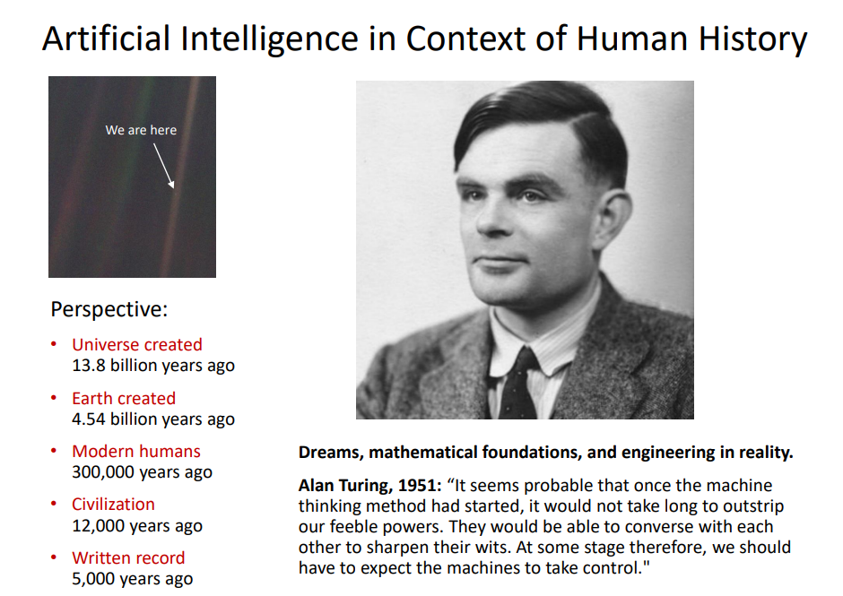

Slide 12
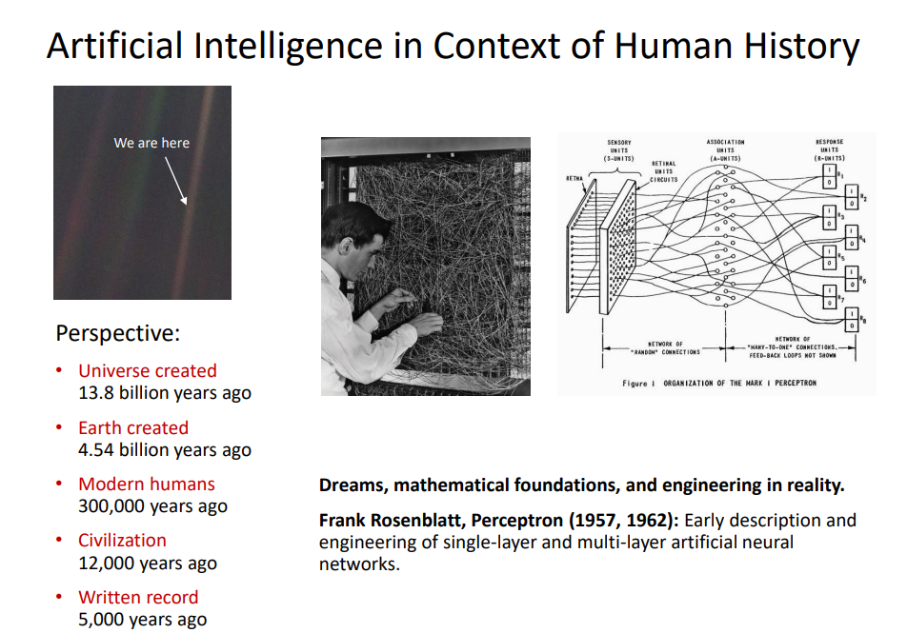

Slide 13
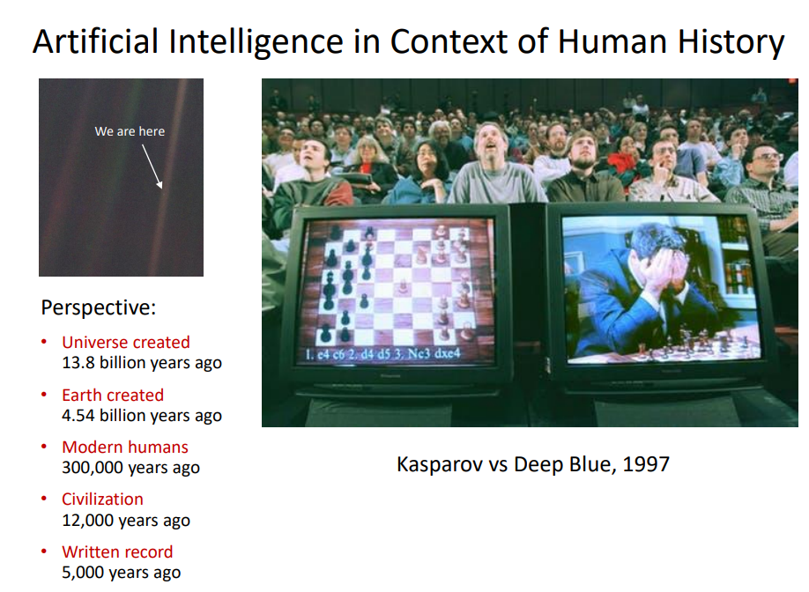
Notes:
200 million positions per second.We must face our fears if we want to get most out of our technology and we must conquer those fears if we want to get the best out of our humanity.

Slide 14
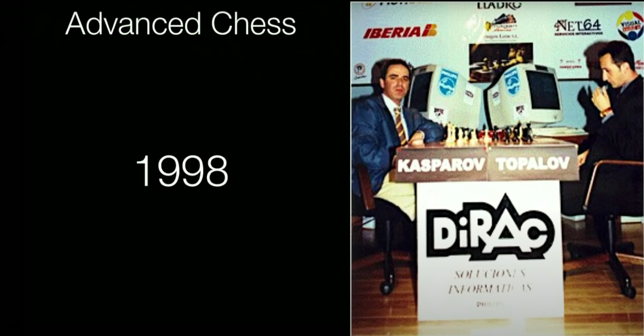
Notes:
Human intuiton+ Machine calculation, Human Strategy+Machine Tactics, Human experience + Machine Memory, Human plus machine against another Elite player but it failed to combine human and machine skills effectively
2005 FreeStyle chess tournament produced a revelation →team of grandmasters and top machines participated but winners were pair of amateurs (not professional players) operating 3 ordinary pcs at a time which gave rise to awareness of a weak human player + a machine + a better process is superior to a powerful machine alone more remarkably is superior to a strong human player + machine + inferior process thus need a better interface to coach machines towards more useful intelligence →RISE OF GPU

Slide 15
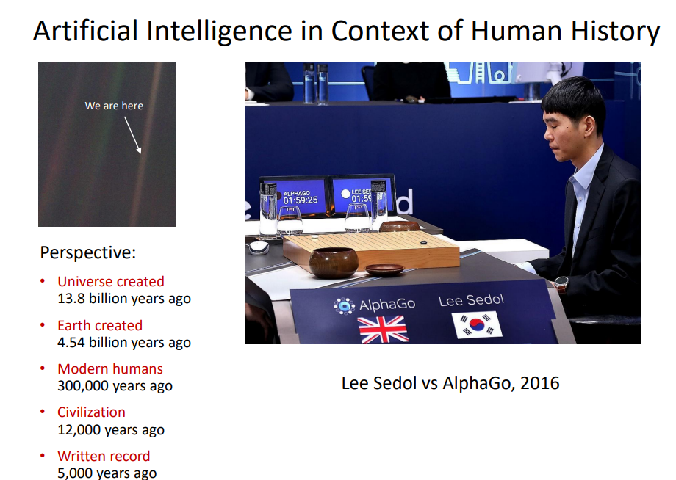
Notes:
Human + Machine is not future it’s the present →Machine crunches data, calculates the probabilities and gets -80-90% of the way making it easier for analysis and decision making of the human party
We don’t get to choose when and where technology progress stops we cannot slow down infact we have to speed up our technology excels at removing uncertainties from our life

Slide 16
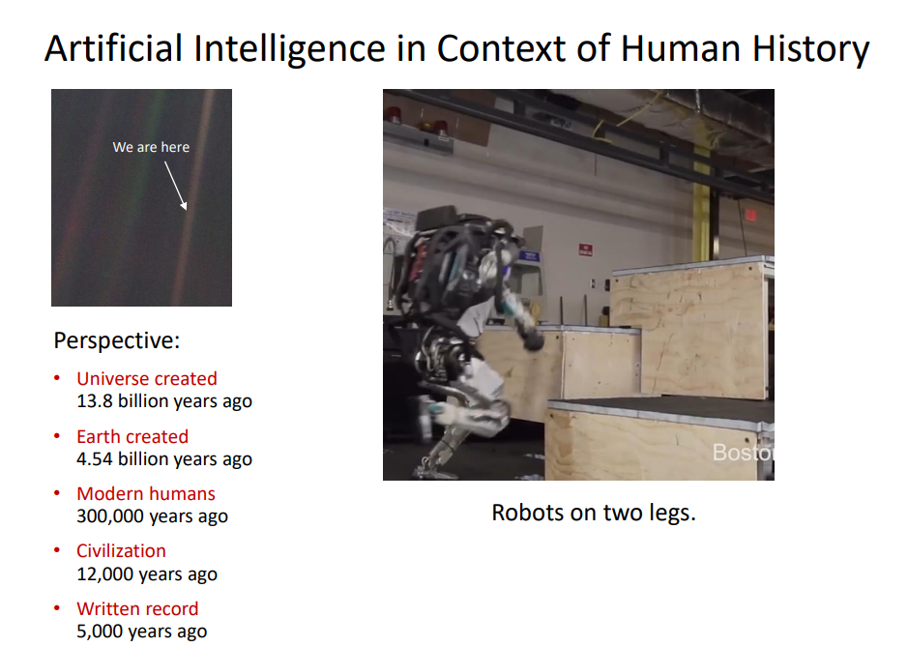
Notes:
Machines have Calculations, we have understanding
Machines have instructions we have purpose
Machines have objectivity we have passion
We should not worry about what our machines can do today ,instead we should worry about what they still cannot do today. Because we will need the help of new, intelligent machines to turn of grandest dreams into reality
One thing only human can do so let us dream big

Slide 17
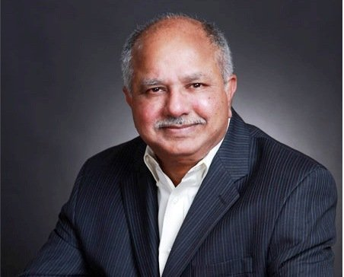
Dr. Dabbala Rajagopal Reddy First Asian to be awarded the A.M. Turing Award - the highest honour in Computer Science

Slide 18
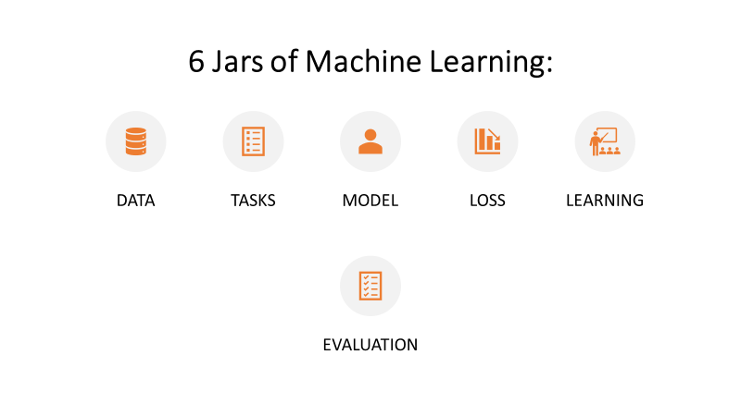

Slide 19

Scikit-Learn Design
The main design principles are :
Consistency - Estimators (fit()),Transformers (fit_transform()) and Predictors (predict() and score()) methods.
Inspection - Estimators hyper-parameters.
Nonproliferation of classes – Datasets are represented as Numpy arrays,instead of homemade classes.
Composition - To create a Pipeline Estimator.
Sensible defaults - Reasonable default values for most parameters

Slide 20
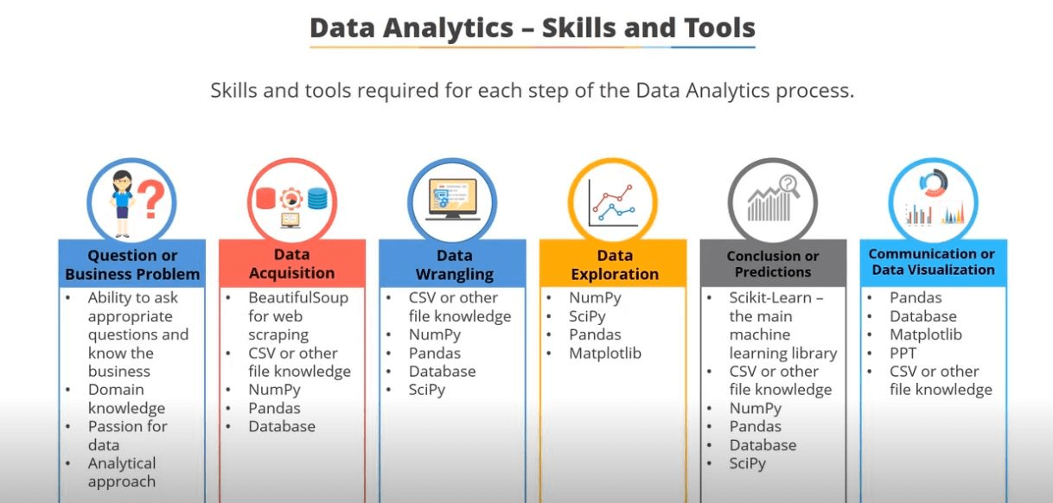

Slide 21
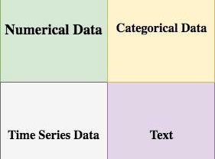
Data
Data might be of any form. Broadly it is categorized as:
Qualitative(Categorical) and Quantitative(Numeric)
Nominal and Ordinal,
Interval and Ratio.
Notes:
Nominal - no numeric such as Blood Group and Gender so no arithmetic operation only mode no other statistical functions.Ordinal is better or greater such as satisfaction very happy,sad and so on.Thus ordering is possible thus quartiles,mean is possible.Whereas for Numeric Interval and ratio arithmetic operations are possible.

Slide 22
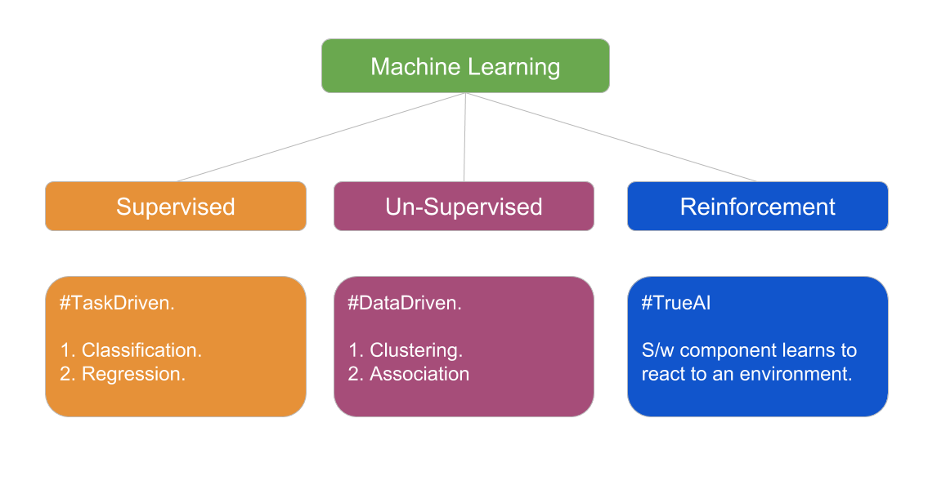

Slide 23
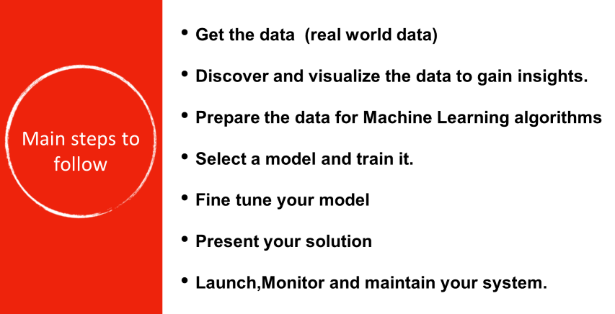

Slide 24
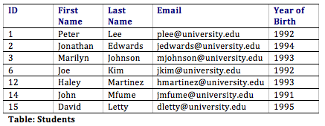
Attributes can also be termed as Feature, Variable, Dimension or Fields

Slide 25

Dataset: Collection of data
Model: Representation of what a ML System has learned from training data
Training : Process of determining the ideal parameters
Learning : Output of the training process,which a Machine Learning model can use to make predictions
Training dataset: subset of the data set to train a model
Validation dataset: Also a subset of dataset,disjunct from training dataset,that we use to adjust hyperparameters
Testing dataset:Used to test model which has gone through initial vetting by validation set.
Hyperparameter:Values which are set before training a model
Parameter:A variable of a model that ML System trains on its own.
Target: Output of the input variable also called as Dependent variable or Response variable.
Key points
Notes:
Talk about ML Cycle,Planning , Data Preparation,Modelling , Model Presentation.

Slide 26
Feature : Individual Independent variables that act as input in your system.These are also called as Independent variables or Predictor variables.
Label : Labels are the final output,such as output classes.
Fit : Capture patterns from provided data.Heart of Modelling.
Evaluate : Determine how accurate the model’s predictions are.
Regularization : Method to estimate a preferred complexity of Machine Learning so that the model generalizes,by avoiding underfitting and overfitting.
Key points

Slide 27
Feature Engineering
Features are individual independent variables. It is an attribute of a dataset.
Feature Engineering - Translating a dataset into features which will be able to represent the dataset more effectively and result in a better learning performance
It has two major elements :
Feature Transformation
Feature Subset-selection.
Feature Transformation - Transforms the data- structured or unstructured into a new set of features which can represent the underlying problem which machine learning is trying to solve. There are two variants of Feature Transformation
Feature Construction
Feature Extraction.

Slide 28
Feature Construction process discovers missing information about the relationships between features and augments the feature space by creating additional features.
Feature Extraction is the process of extracting or creating a new set of features from the original set of features by doing some transformation in order to remove redundancy. Thus new features can represent the data very likely to the old features.
Unlike Feature Transformation, in case of Feature Subset-selection (Feature Selection) no new feature is generated. The objective of feature selection is to derive a subset of features from the full feature set which is most meaningful in the context of a specific machine learning problem

Slide 29
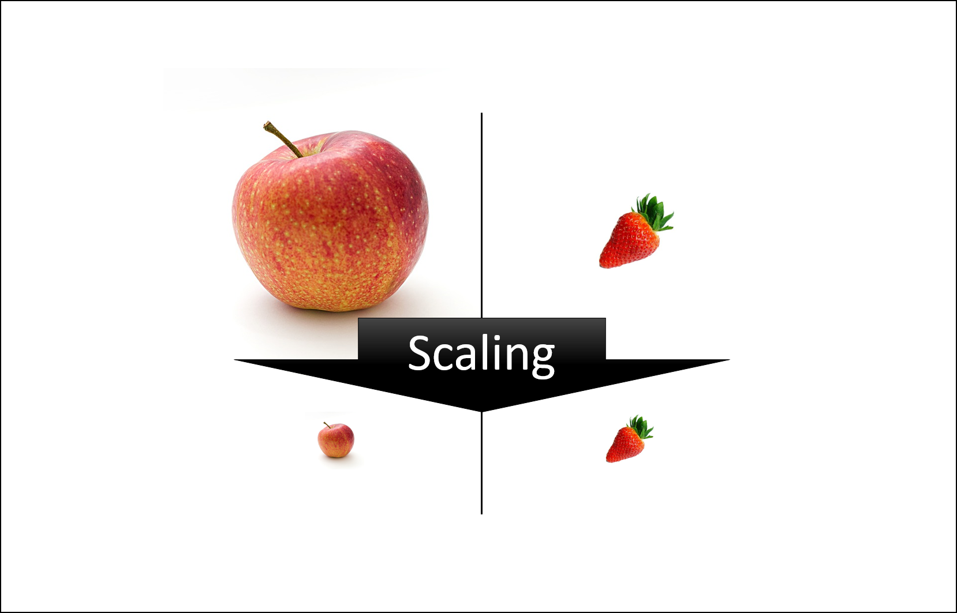
Feature Scaling
Feature scaling in machine learning is one of the most critical steps during the pre-processing of data before creating a machine learning model.
Scaling can make a difference between a weak machine learning model and a better one.
The most common techniques of feature scaling are Normalization and Standardization.

Slide 30
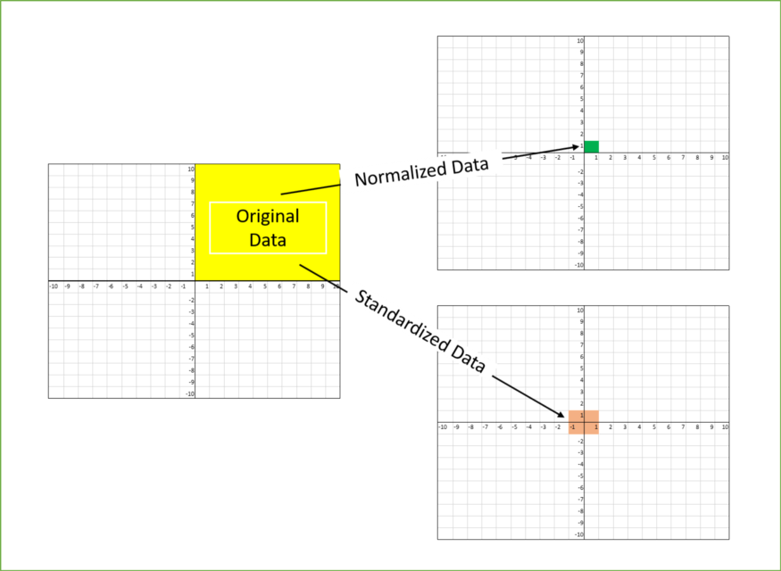
Normalization is used when we want to bound our values between two numbers, typically, between [0,1] or [-1,1].
While Standardization transforms the data to have zero mean and a variance of 1, they make our data unitless.

Slide 31

FEATURE SCALING
That’s why we scale the numeric features.
PRODUCT ID | PRICE IN INDIA(inr) | PRICE IN USA ($)
Features
ID-1 | 5000 | 80
ID-2 | 7000 | 50
ID-3 | 12000 | 140
ID-4 | 3000 | 25
5000 | 80
5000
>
80
Here can we say that the price in India is higher than the price in USA?
5000 INR
<
80 $
1 $
=
75 INR
We can only feed numbers in our machine learning algorithms.
80 75
=
6000 INR
UNIT
MAGNITUDE

Slide 32
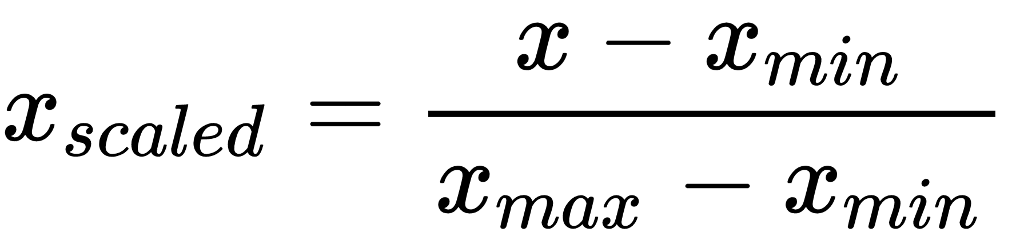
FEATURE SCALING
PRODUCT ID | PRICE IN INDIA(inr) | PRICE IN USA ($)
Min - Max Normalization
ID-1 | 5000 | 80
ID-2 | 7000 | 50
ID-3 | 12000 | 140
ID-4 | 3000 | 25
X
Feature scaling is a technique to standardize the independent features present in the data in fixed range.
5000 - 3000
12000 - 3000
= 0.22

Slide 33
FEATURE SCALING
PRODUCT ID | PRICE IN INDIA(inr) | PRICE IN USA ($)
Min - Max Normalization
ID-1 | 5000 | 80
ID-2 | 7000 | 50
ID-3 | 12000 | 140
ID-4 | 3000 | 25
X
Feature scaling is a technique to standardize the independent features present in the data in fixed range.
80 - 25
140 - 25
= 0.47

Slide 34
FEATURE SCALING
PRODUCT ID | PRICE
ID-1 | 50
ID-2 | 7000
ID-3 | 12000
ID-4 | 30
USD
INR

Slide 35
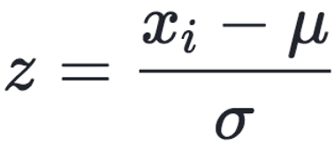
FEATURE SCALING
PRODUCT ID | PRICE IN INDIA(inr) | PRICE IN USA ($)
Standardization
ID-1 | 5000 | 80
ID-2 | 7000 | 50
ID-3 | 12000 | 140
ID-4 | 3000 | 25
Xi
Mean
Standard Deviation
5000 - 6750
3862.21
= - 0.45
Feature scaling is a technique to standardize the independent features present in the data in fixed range.
80 - 73.75
49.56
= - 0.12

Slide 36
FEATURE SCALING
PRODUCT ID | PRICE
ID-1 | 50
ID-2 | 7000
ID-3 | 12000
ID-4 | 30
USD
INR

Slide 37
Machine learning algorithm just sees number — if there is a vast difference in the range say few ranging in thousands and few ranging in the tens, and it makes the underlying assumption that higher ranging numbers have superiority of some sort.
So these more significant number starts playing a more decisive role while training the model.

Slide 38


